Slide 1





ATLIQ HARDWARE
AD-HOC INSIGHTS
Domain: Consumer Goods
Created By: Divya Pardeshi

Slide 2
CONTENT
Problem Statement
Database Overview
Ad- hoc Requests & Insights
02
04
06
01
03
05
07
Company Overview
Objective
Requests
& Tools
Recommendations

Slide 3

COMPANY OVERVIEW
AtliQ Hardwares (a fictitious company) is a prominent computer hardware manufacturer based in India, with a robust presence in India and international markets.
The company specializes in producing a wide range of products including peripherals, accessories, network and storage devices, and personal computers.
Known for its innovation and quality, AtliQ Hardwares is committed to delivering superior products to its customers globally.
However, the company recognizes the need to enhance its data-driven decision-making capabilities to maintain and grow its competitive edge.

Slide 4

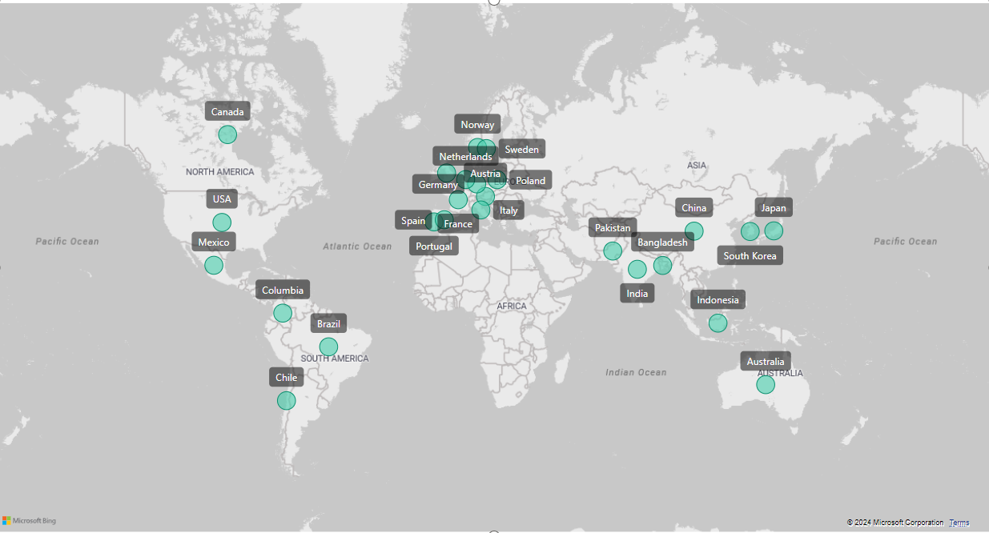
ATLIQ’S MARKET

Slide 5

ATLIQ’S PRODUCT-LINE
Business Laptop
Personal Desktop
Internal HDD
Graphic Card
Processors
MotherBoard
Desktop
Peripherals
PC
P & A
Personal Laptop
Business Laptop
Gaming Laptop
Notebook
Accessories
Mouse
Keyboard
Batteries
N & S
Networking
Storage
Wi fi extender
External Solid State Drives
USB Flash Drives

Slide 6

PROBLEM STATEMENT
AtliQ Hardwares faces challenges in making prompt, wise, and data-informed decisions due to a lack of sufficient insights. This gap in actionable data affects the company's ability to optimize its strategies and operations.
To address this issue, AtliQ Hardwares plans to expand its data analytics team by hiring junior data analysts. Tony Sharma, the Data Analytics Director, has designed a SQL challenge to evaluate the candidates' technical and soft skills.
The company aims to gain valuable insights from this challenge, focusing on 10 specific ad hoc requests to improve their strategic decision-making processes.

Slide 7

OBJECTIVE
The primary objective of this project is to fulfill 10 specific data requests by employing SQL for data extraction and analysis, complemented by Power BI for data visualization.
This dual approach is designed to generate actionable insights, thereby enhancing AtliQ Hardwares' strategic decision-making processes and bolstering the company's overall growth and operational efficiency.

Slide 8

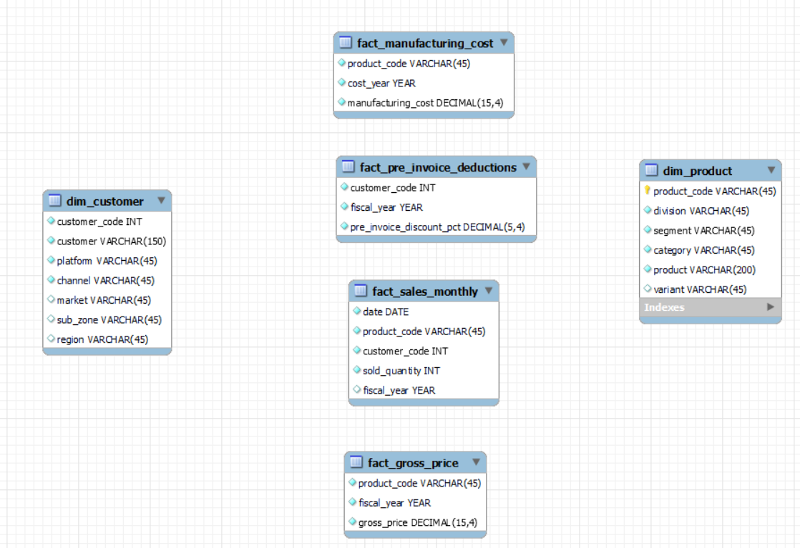
DATABASE OVERVIEW

Slide 9
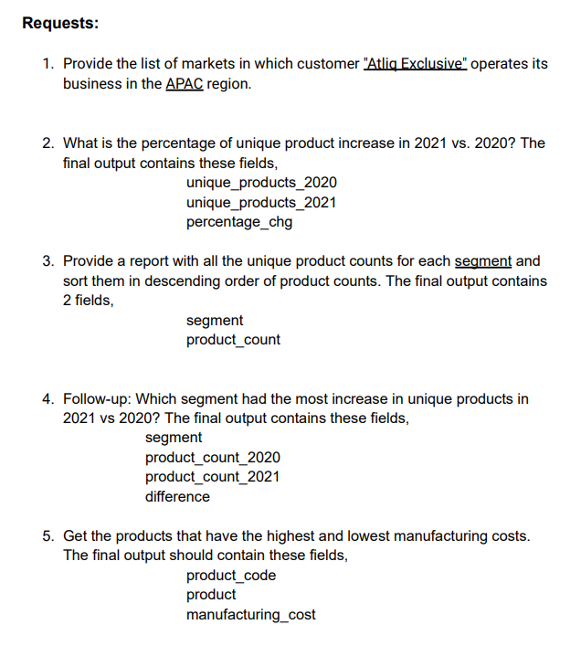
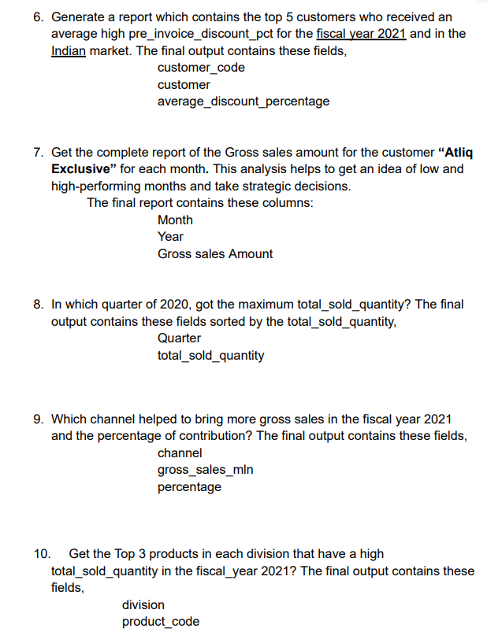


&
REQUESTS
TOOLS
For Analysis & Visualisation

Slide 10
AD- HOC REQUESTS, QUERIED RESULTS, INSIGHTS &
VISUALISATIONS

Slide 11
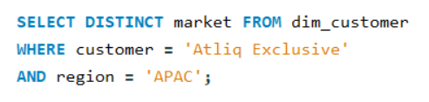
REQUEST- 1
Provide the list of markets in which customer "Atliq Exclusive" operates its business in the APAC region.
INPUT

Slide 12
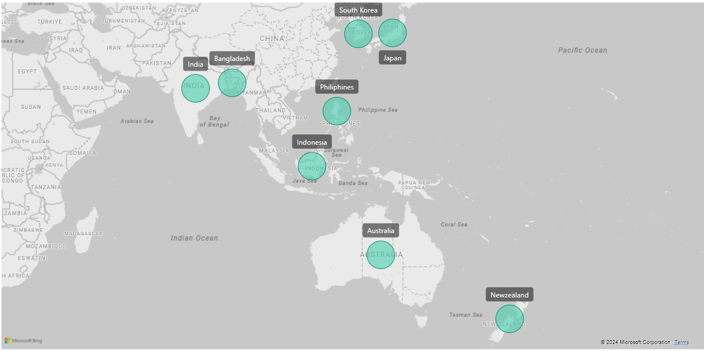
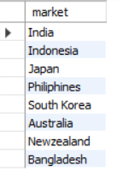
OUTPUT
INSIGHTS
In the APAC region, our Atliq Exclusive store has established its presence in 8 major markets.

Slide 13
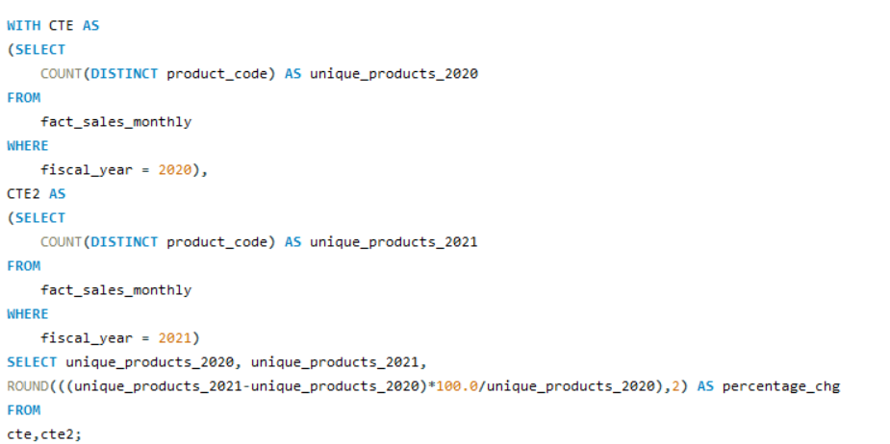
REQUEST- 2
What is the percentage of unique product increase in 2021 vs. 2020? The final output contains these fields:
unique_products_2020, unique_products_2021
& percentage_chg
INPUT

Slide 14
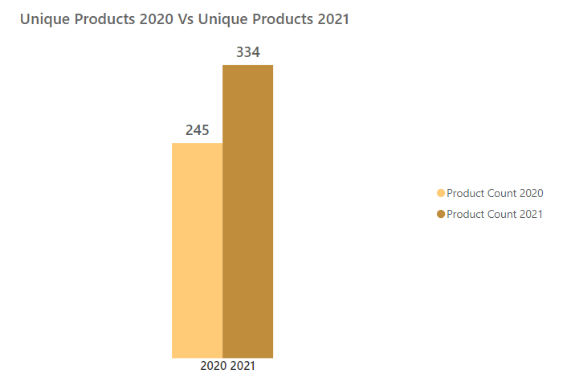

OUTPUT
Percentage Change
36.33%
INSIGHTS
The number of unique products grew from 245 in 2020 to 334 in 2021, marking a 36.33% increase.
This significant increase highlights the company's commitment to innovation and meeting diverse customer needs.

Slide 15
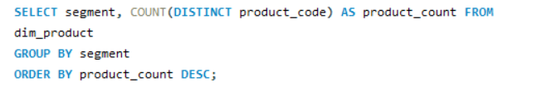
REQUEST- 3
Provide a report with all the unique product counts for each segment and sort them in descending order of product counts. The final output contains 2 fields: segment & product_count
INPUT

Slide 16
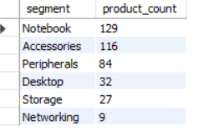
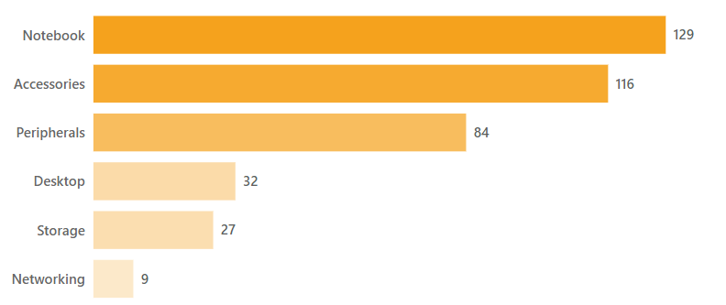
OUTPUT
INSIGHTS
Notebooks, Accessories, and Peripherals constitute the core of AtliQ’s product line, comprising a substantial 82.87% of the product portfolio.
Desktops, Storage, and Networking currently represent a smaller 17.13% share.
To optimize growth, AtliQ should prioritize product offerings within the dominant segment that resonate with current market trends.

Slide 17
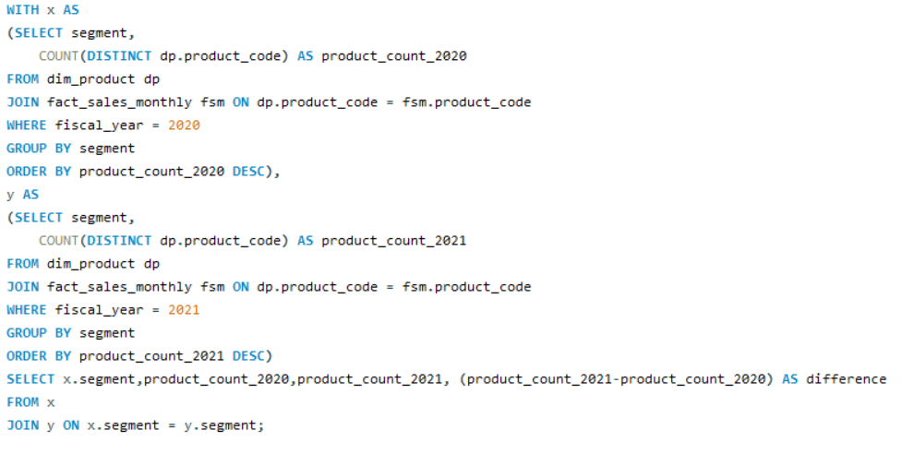
REQUEST- 4
Follow-up: Which segment had the most increase in unique products in 2021 vs 2020? The final output contains these fields:
segment, product_count_2020, product_count_2021 & difference
INPUT

Slide 18
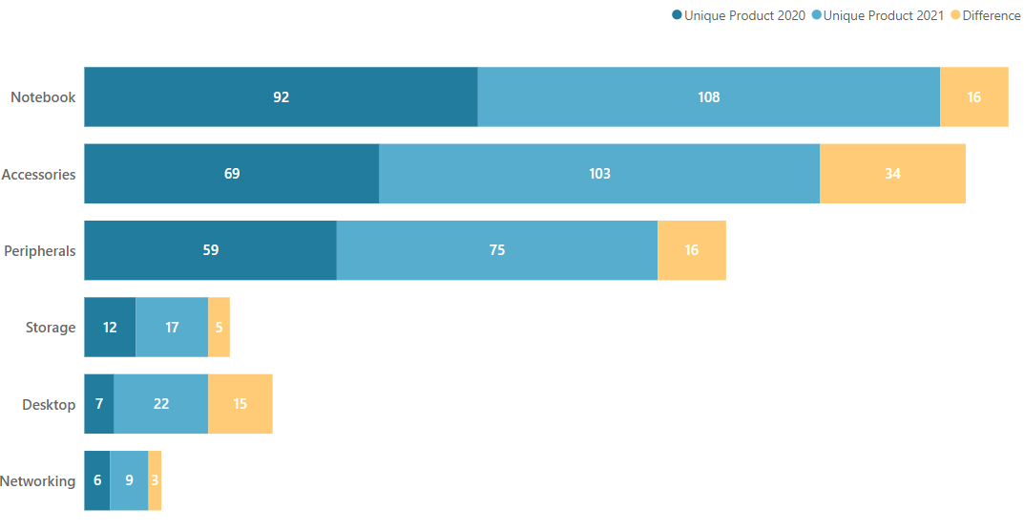
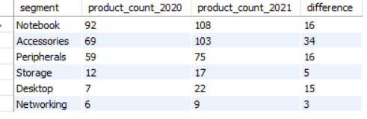
OUTPUT
INSIGHTS
Each division has seen an increase in the number of unique products from 2020 to 2021, indicating expansion and diversification in product offerings across all categories.
Accessories have the most increased products from 2020 to 2021, with an increase of 34 new products.

Slide 19
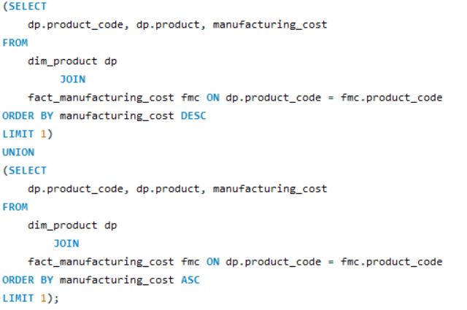
REQUEST- 5
Get the products that have the highest and lowest manufacturing costs. The final output should contain these fields:
product_code, product & product manufacturing_cost
INPUT

Slide 20



OUTPUT
Highest Manufacturing Cost Product
Lowest Manufacturing Cost Product
AQ Home Allin1 Gen2
AQ Master wired x1 Ms
INSIGHTS
Personal Desktop: AQ Home Allin1 Gen2 (Variant: Plus3) has the highest
manufacturing cost.
Mouse: AQ Master wired x1 Ms (Variant: Standard1) has the lowest manufacturing cost.

Slide 21
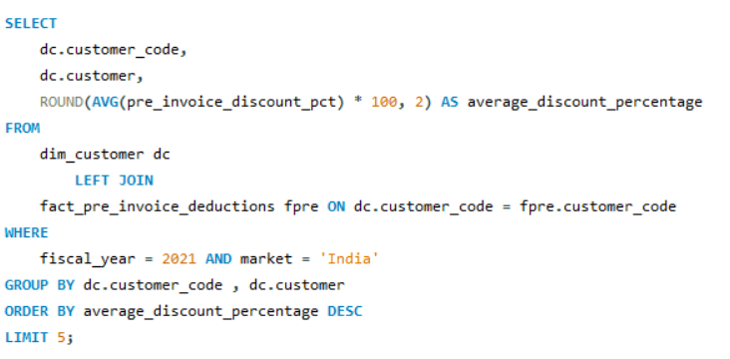
REQUEST- 6
Generate a report which contains the top 5 customers who received an average high pre_invoice_discount_pct for the fiscal year 2021 and in the Indian market.The final output contains these fields: customer_code, customer & average_discount_percentage
INPUT

Slide 22
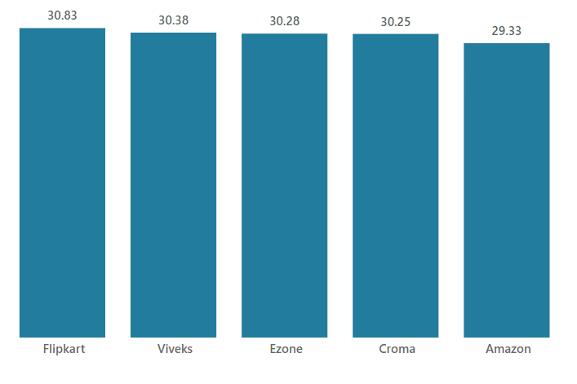
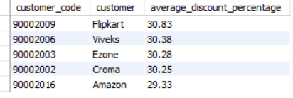
Top 5 Indian customers with highest average percentage discount for FY 2021
OUTPUT
INSIGHTS
Flipkart is the most heavily discounted customer in the Indian market, with a pre-invoice discount percentage of 30.63%
The least average pre-invoice discount percentage of 29.33% was given to Amazon.

Slide 23
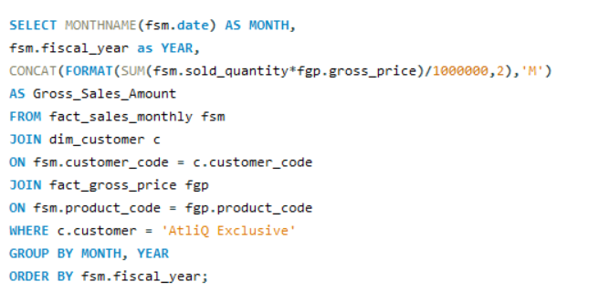
REQUEST- 7
Get the complete report of the Gross sales amount for the customer “Atliq Exclusive” for each month. This analysis helps to get an idea of low and high-performing months and take strategic decisions. The final report contains these columns: Month, Year & Gross sales Amount
INPUT

Slide 24
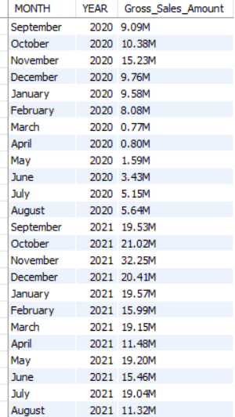
OUTPUT
INSIGHTS
Atliq Exclusive saw the highest Gross sales in the month of November 2021 and lowest sales in the month of March & April 2020

Slide 25
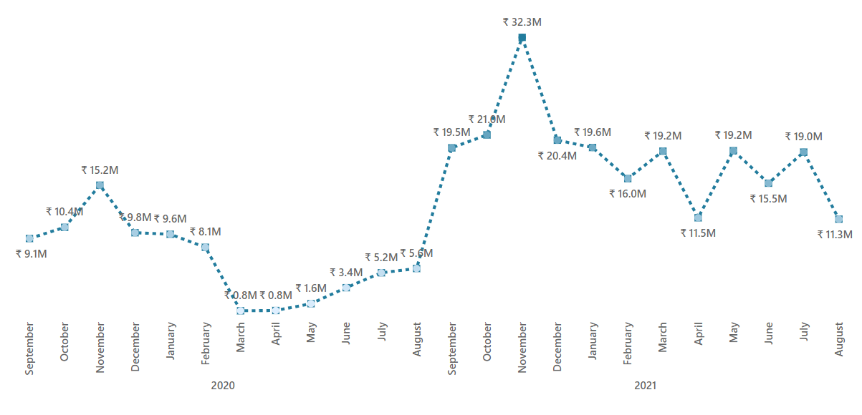
Highest Gross
sales 32.25M
Lowest Gross
sales 0.8M
INSIGHTS
The decline in sales between March and August can be attributed to the impact of
COVID-19.
However, it’s encouraging to see that sales have steadily climbed since the pandemic and remain strong compared to 2020.

Slide 26
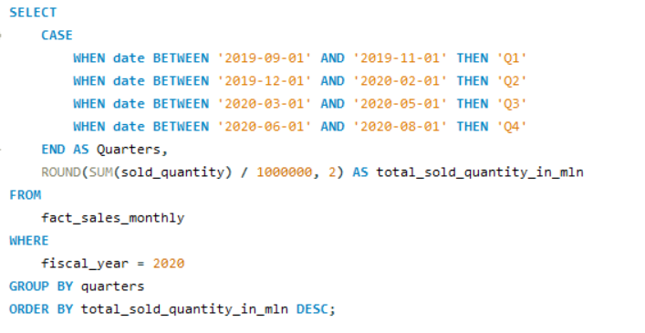
REQUEST- 8
In which quarter of 2020, got the maximum total_sold_quantity? The final output contains these fields sorted by the total_sold_quantity, Quarter total_sold_quantity
INPUT

Slide 27
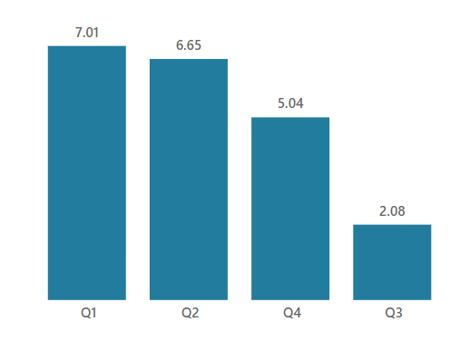
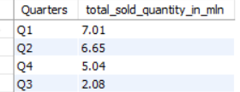
Quarter 1 has the maximum
total sold quantity
OUTPUT
INSIGHTS
Q1 of FY 2020 marked the peak sales period, demonstrating exceptional performance at the start of the financial year.
AtliQ encountered a significant decline in sales during Q3 (March, April, May), possibly due to the COVID-19 pandemic, reflecting challenging market conditions and shifting consumer behavior.

Slide 28
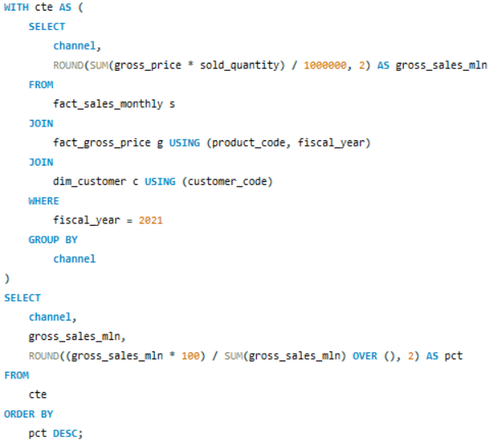
REQUEST- 9
Which channel helped to bring more gross sales in the fiscal year 2021 and the percentage of contribution? The final output contains these fields,
channel, gross_sales_mln & percentage
INPUT

Slide 29
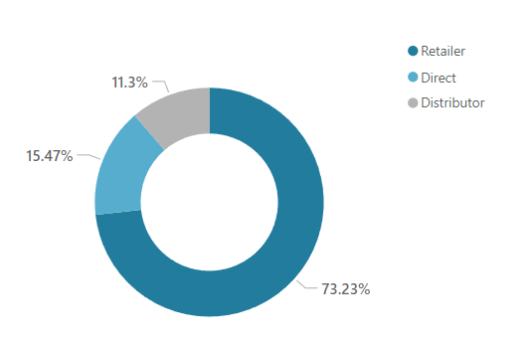
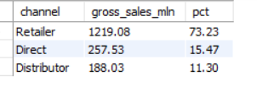
OUTPUT
INSIGHTS
Retailers account for 73.23% of total sales which is the highest, indicating they are the primary sales channel for AtliQ Hardwares.
Direct sales contribute 15.47%, while distributor sales make up 11.3% of the total sales.

Slide 30
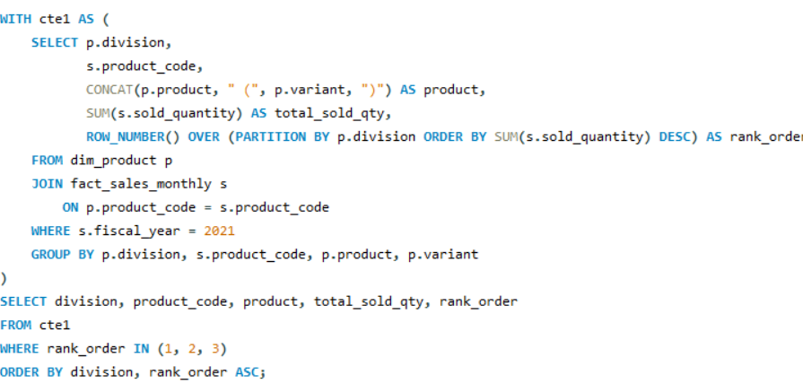
REQUEST- 10
Get the Top 3 products in each division that have a high total_sold_quantity in the fiscal_year 2021? The final output contains these fields,
division, product_code, product, total_sold_quantity & rank_order
INPUT

Slide 31
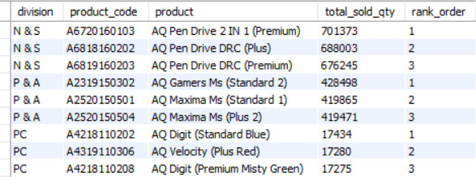
OUTPUT

Slide 32
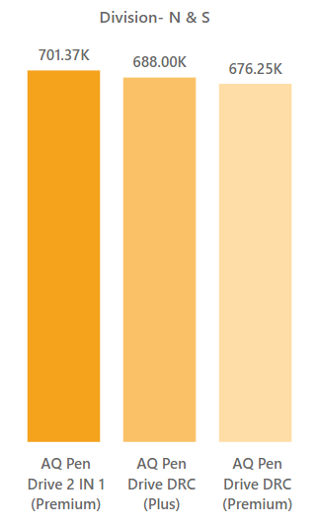
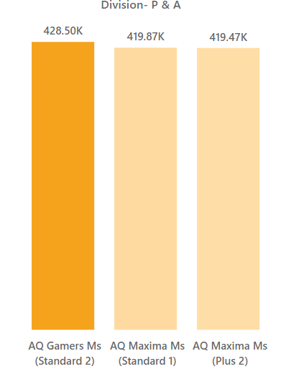
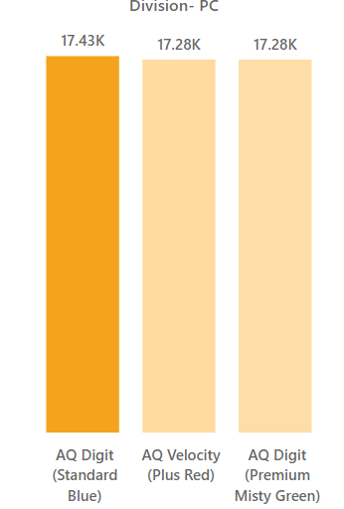
INSIGHTS
The top 3 selling products in
N&S division were pen drives, which were around 7 lakh in quantity.
The top 3 selling products in P&A division were mouse, which were around 4 lakh in quantity.
The top 3 selling products in PC were personal laptops, which were around 17000 in quantity.

Slide 33
RECOMMENDATIONS
Concentrate on expanding product lines within Notebooks, Accessories, and Peripherals, which comprise a significant portion of the product portfolio.
Since retailers account for the majority of sales, it is crucial to maintain and enhance relationships with retail partners.
Increase direct sales efforts to capture a larger market share, focusing on customer experience and personalized service.
Conduct regular market analysis to stay informed about changing market conditions and consumer behavior.
Adjust marketing strategies based on insights gained from market analysis to remain competitive and responsive to customer needs.
Implement targeted marketing and promotional campaigns during high-performing months to maximize sales.
Strengthen the supply chain to ensure stability and reliability during unforeseen events.
Continuously review and optimize manufacturing costs to maintain competitive pricing without compromising quality.

Slide 34
THANK YOU!

